Slide 1

Spock Groovy

Slide 2
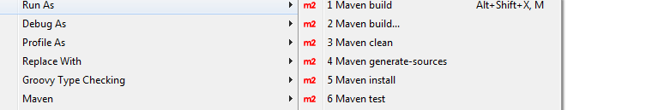
Spock Groovy - Maven

Slide 3
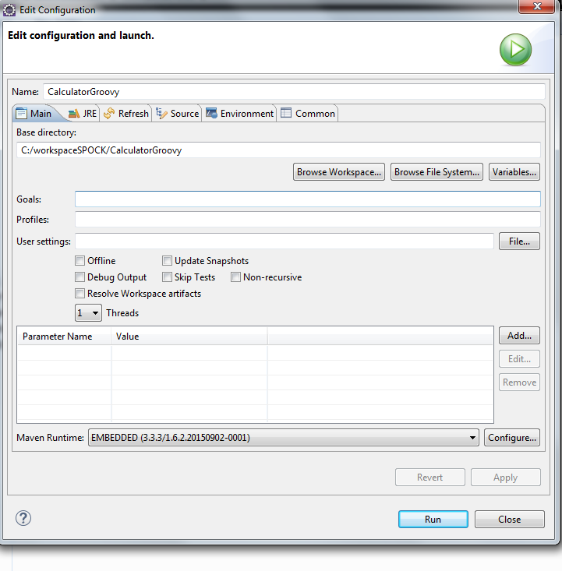
Spock Groovy – Maven - Build

Slide 4
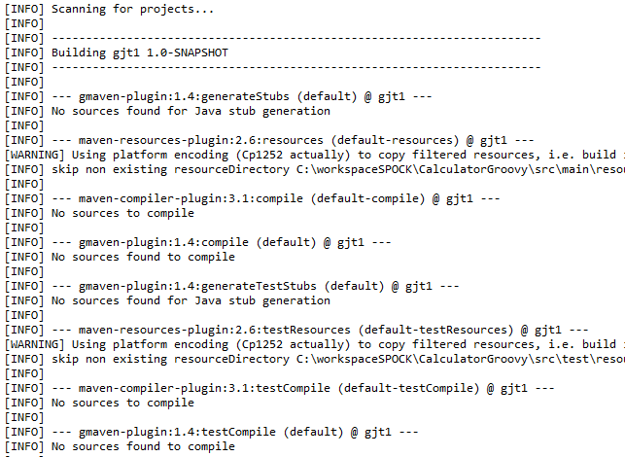
Spock Groovy – Maven - Build

Slide 5
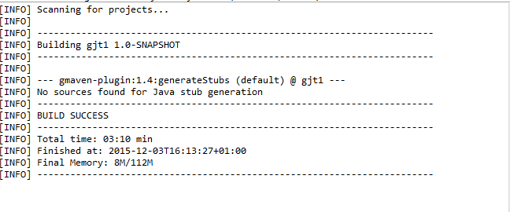
Spock Groovy – Maven – GenerateSources

Slide 6
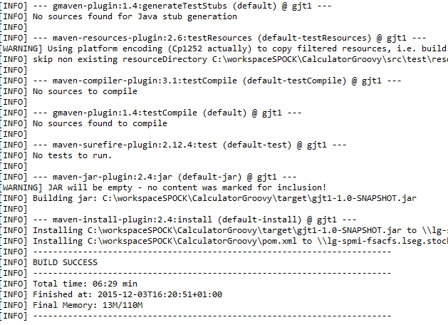
Spock Groovy – Maven – Generate Sources

Slide 7
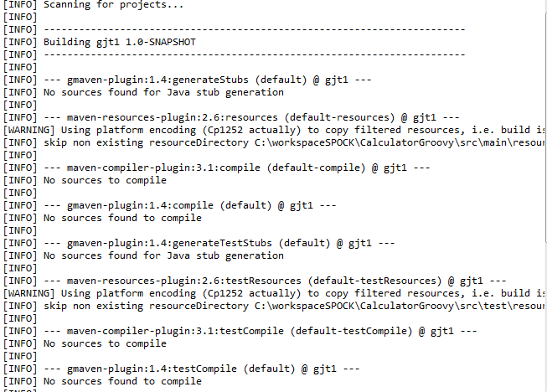
Spock Groovy – Building

Slide 8
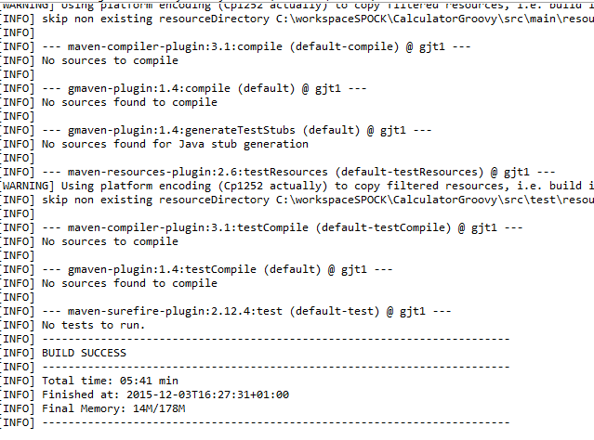
Spock Groovy – Building

Slide 9
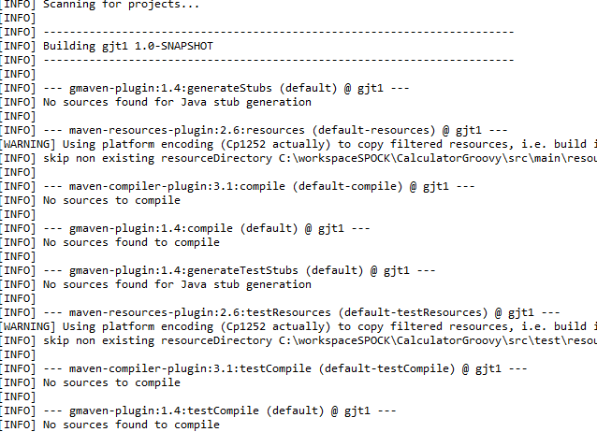
Spock Groovy – Building

Slide 10
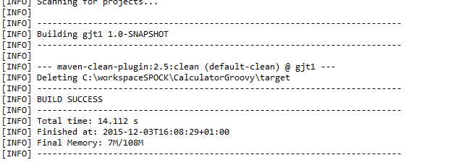
Spock Groovy – Building

Slide 11
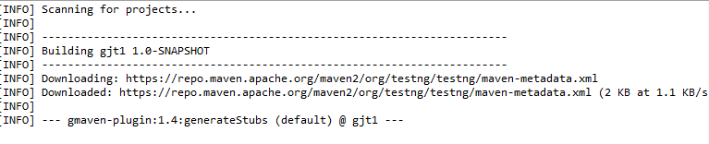
Spock Groovy – Maven – Test

Slide 12
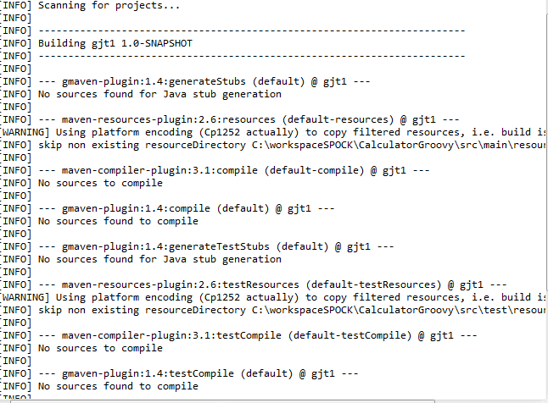
Spock Groovy – Test

Slide 13
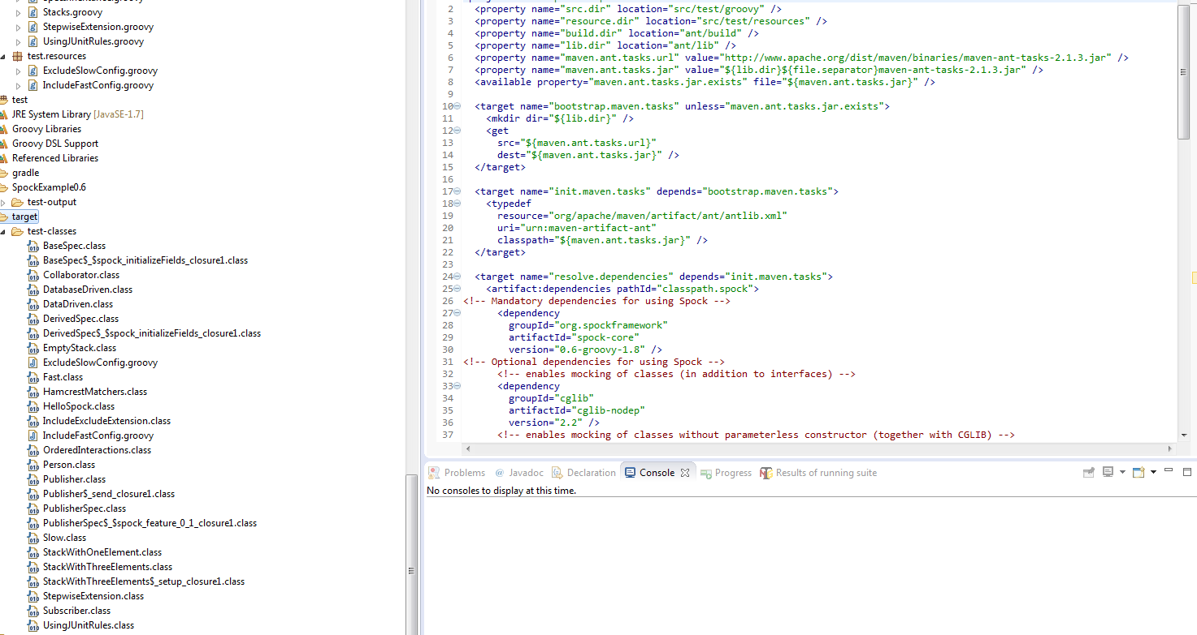
Spock Groovy – Maven – TargetRoot classes

Slide 14
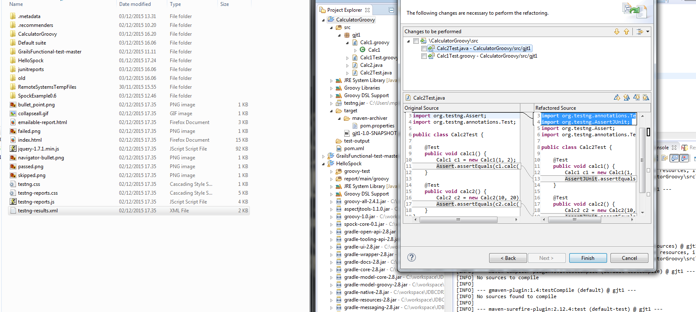
Spock Groovy – TestNG - RunTestSuite

Slide 15
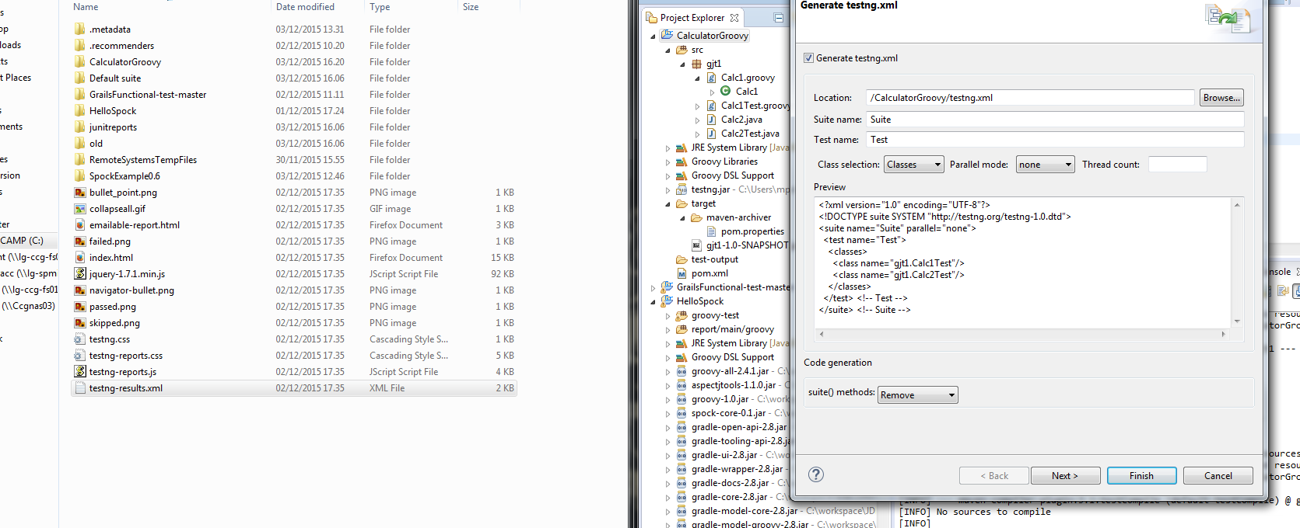
Spock Groovy – Maven – Generate TestSuite

Slide 16
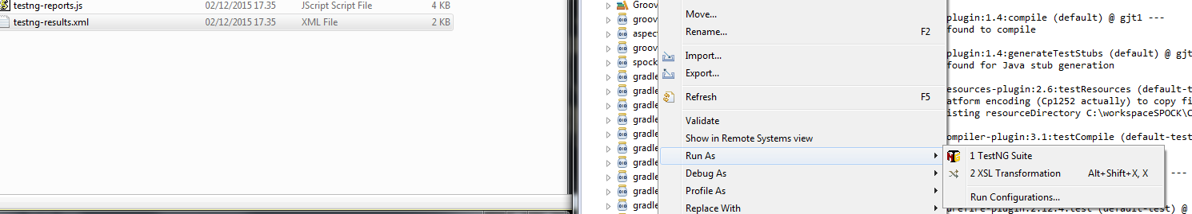
Spock Groovy – TestNG – RunTestSuite

Slide 17
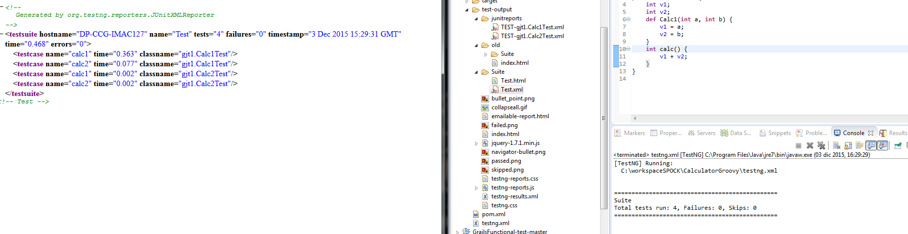
Spock Groovy – TestNG – TestSuite

Slide 18
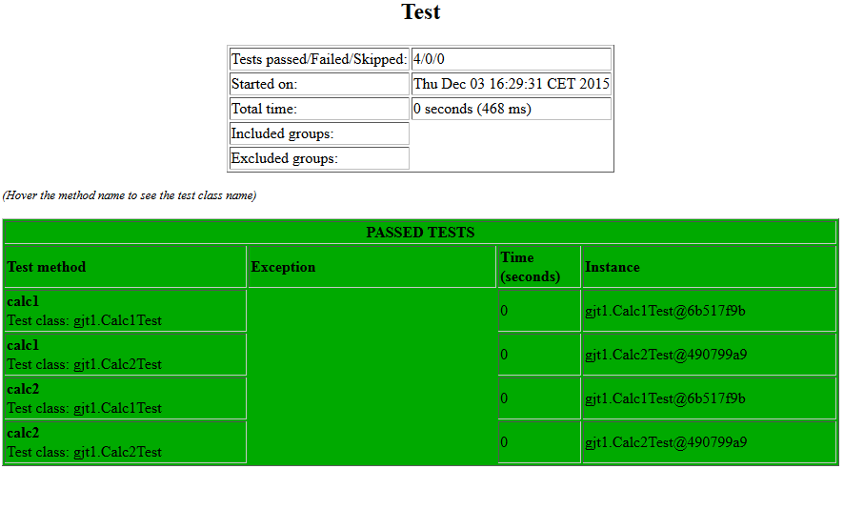
Spock Groovy – TestNG – RunTestSuite - HTML

Slide 19
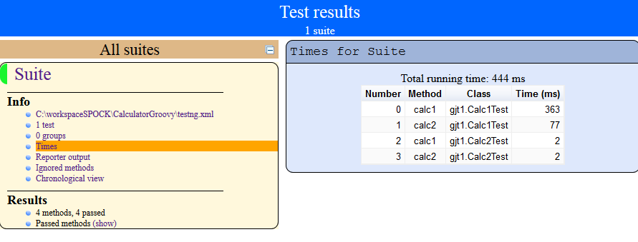
Spock Groovy – TestNG – RunTestSuite - HTML

Slide 20
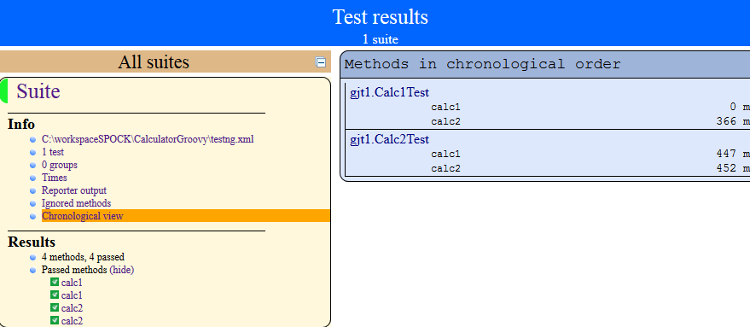
Spock Groovy – TestNG – TestSuite - HTML

Slide 21
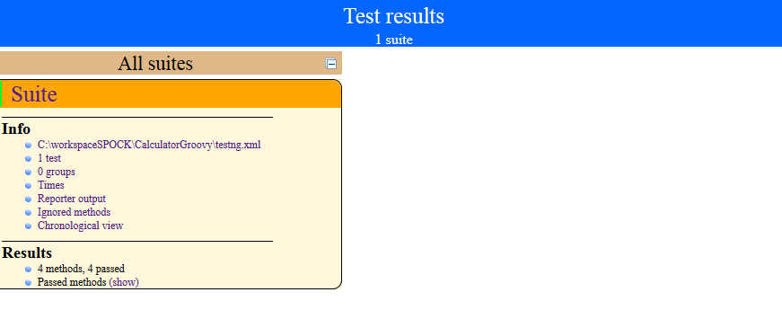
Spock Groovy – TestNG – TestSuite - HTML

Slide 22
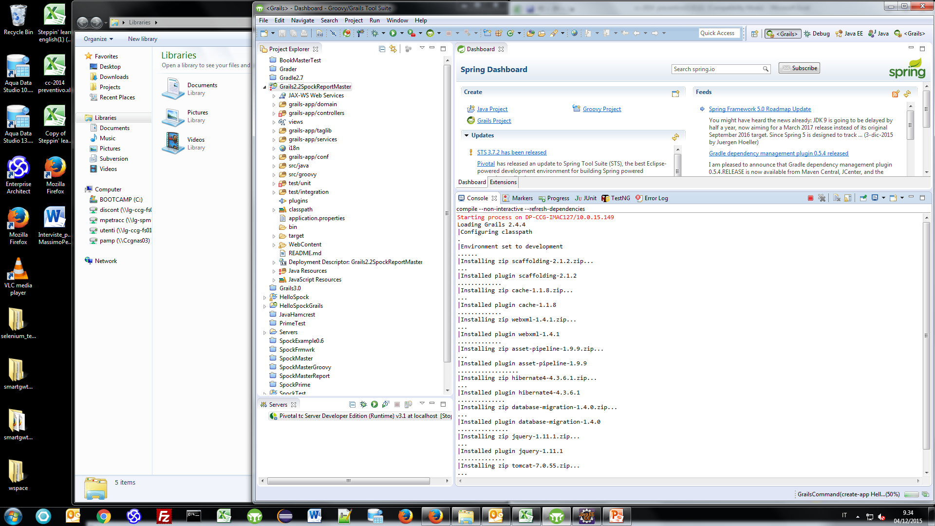
Spock Groovy – Spring Grails – Configurazione Pivotal tc server

Slide 23
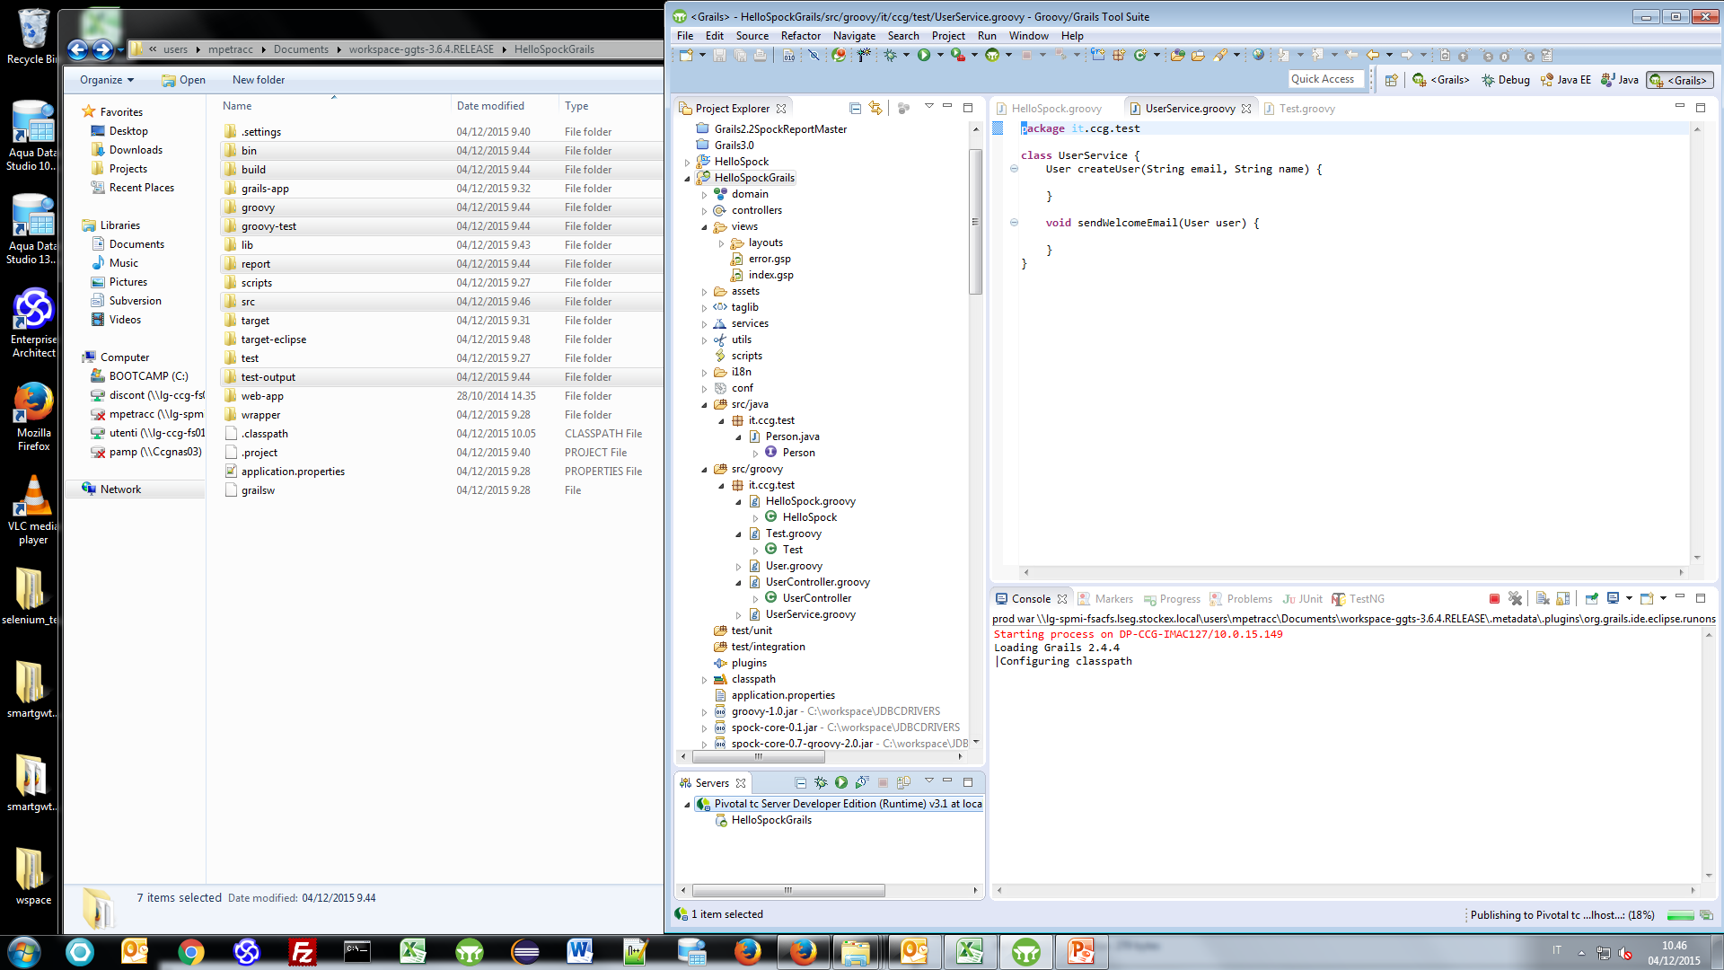
Spock Groovy – Spring Grails – Configurazione Pivotal tc server

Slide 24
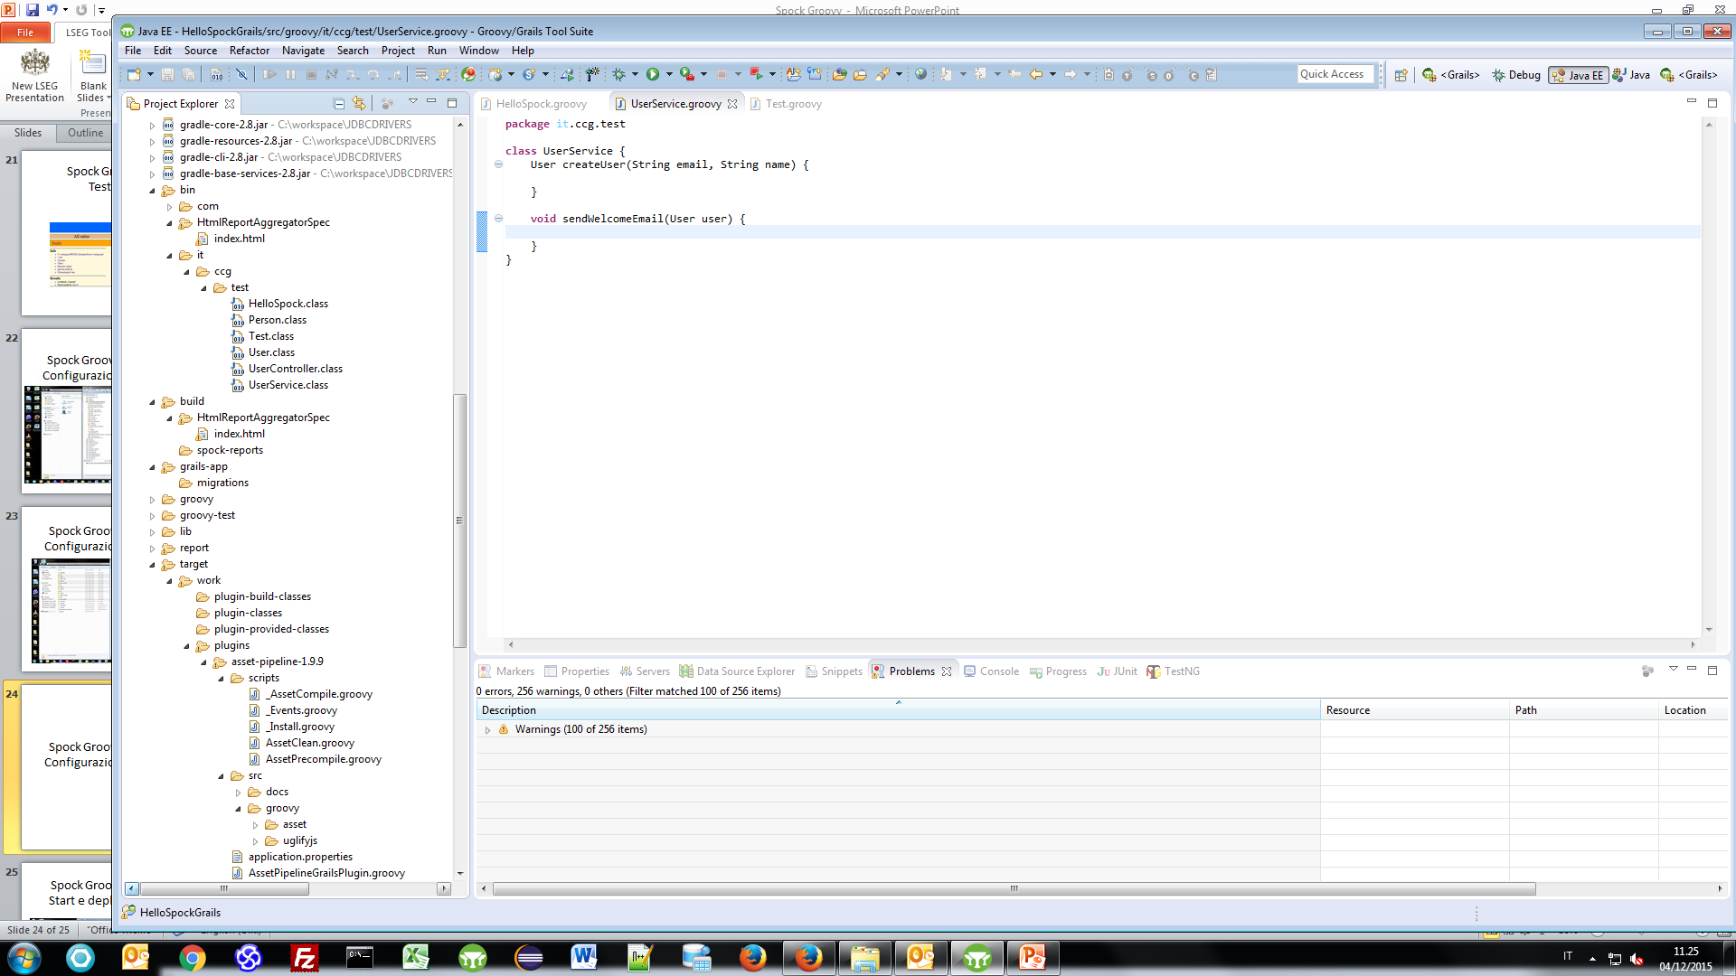
Spock Groovy – Spring Grails – Compile and building classes

Slide 25
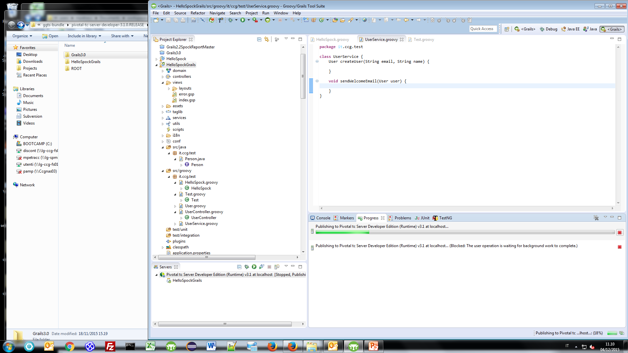
Spock Groovy – Spring Grails – Start e deploy Pivotal tc server

Slide 26
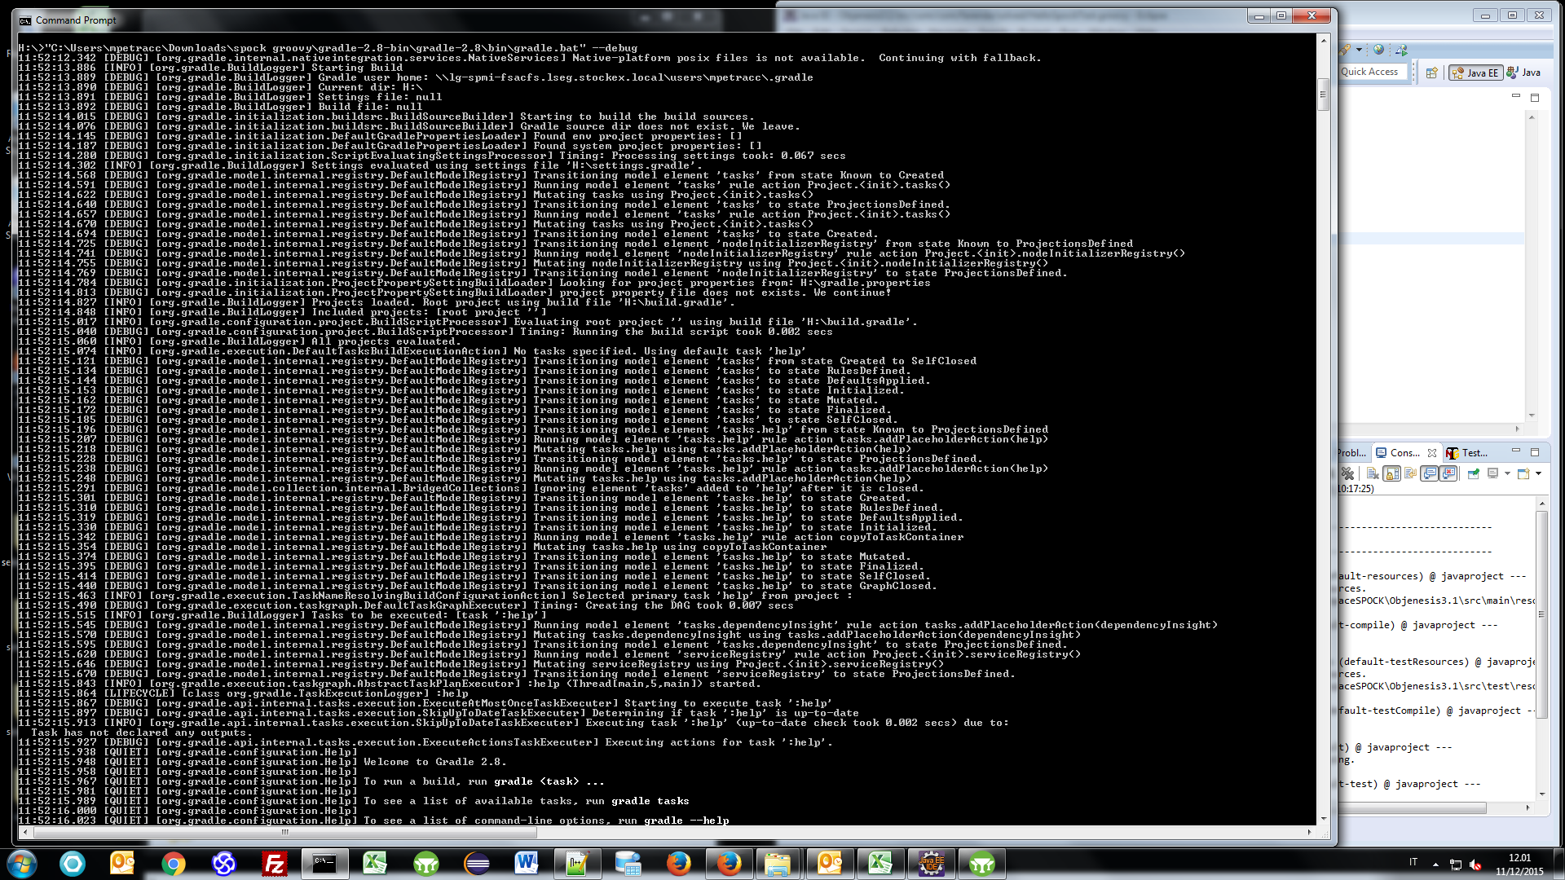
Spock Groovy – Grails win64 installation

Slide 27
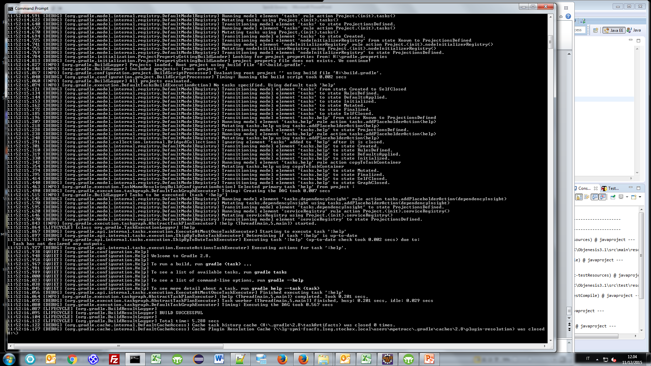
Spock Groovy – Grails win64 installation

Slide 28
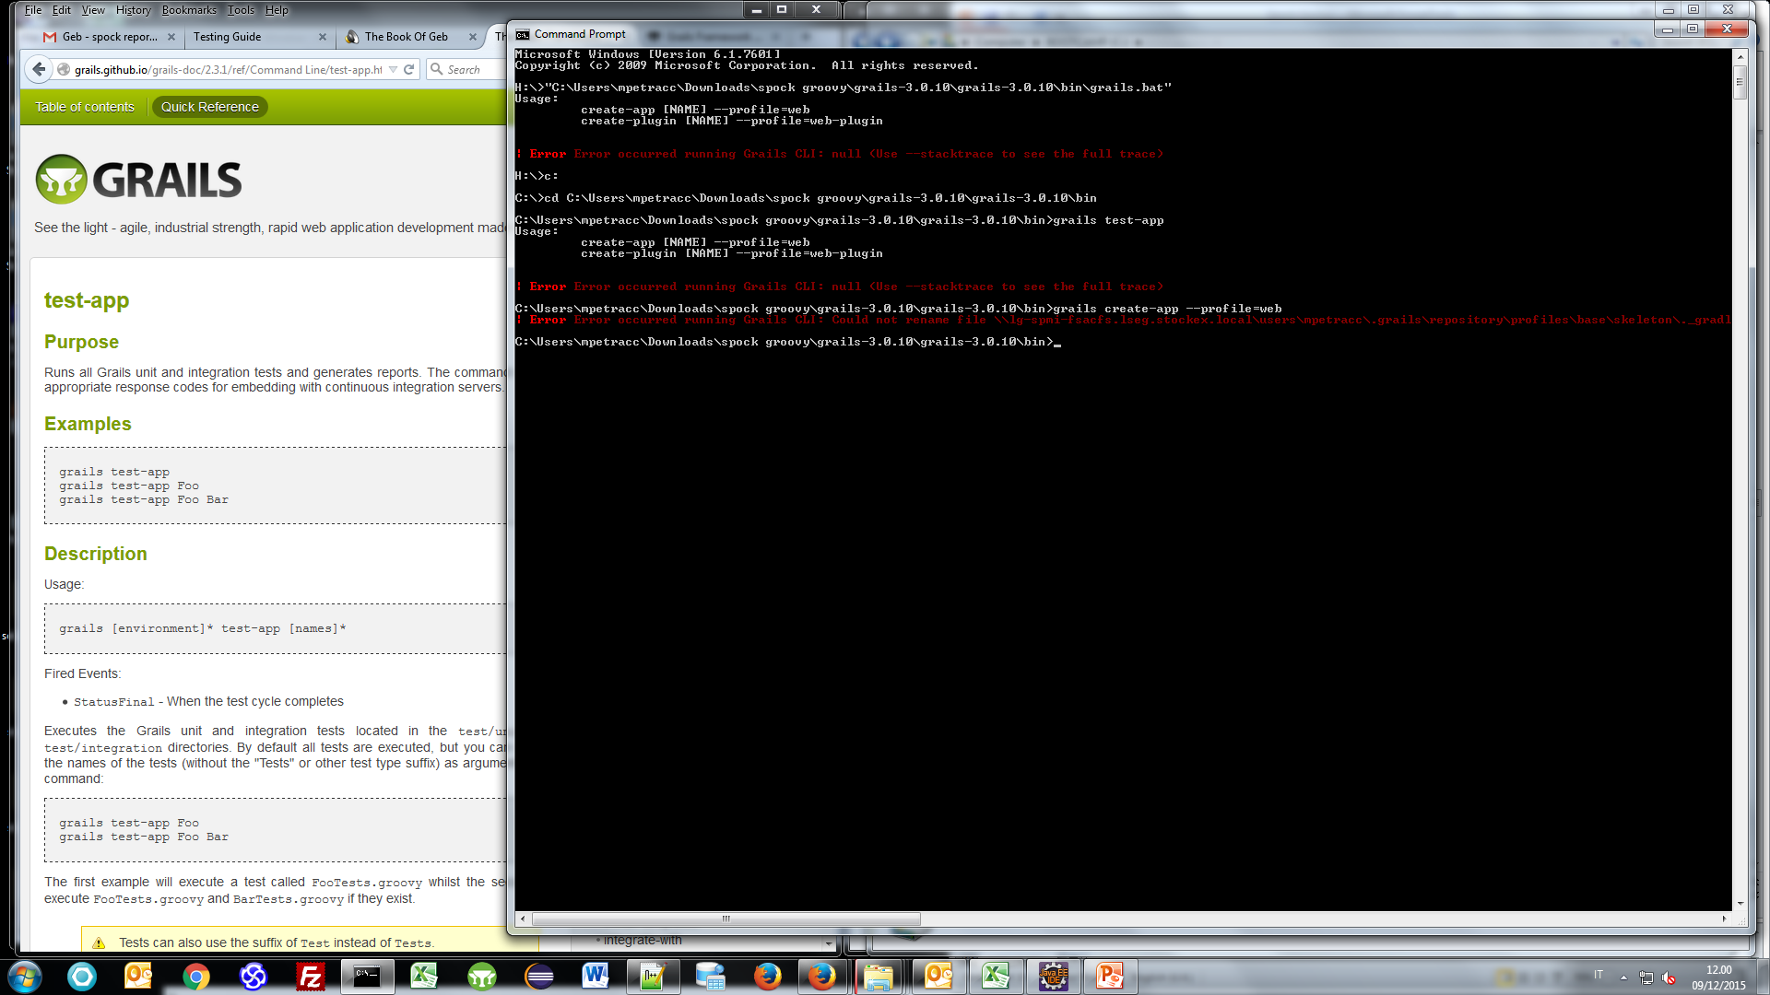
Spock Groovy – Spring Grails

Slide 29
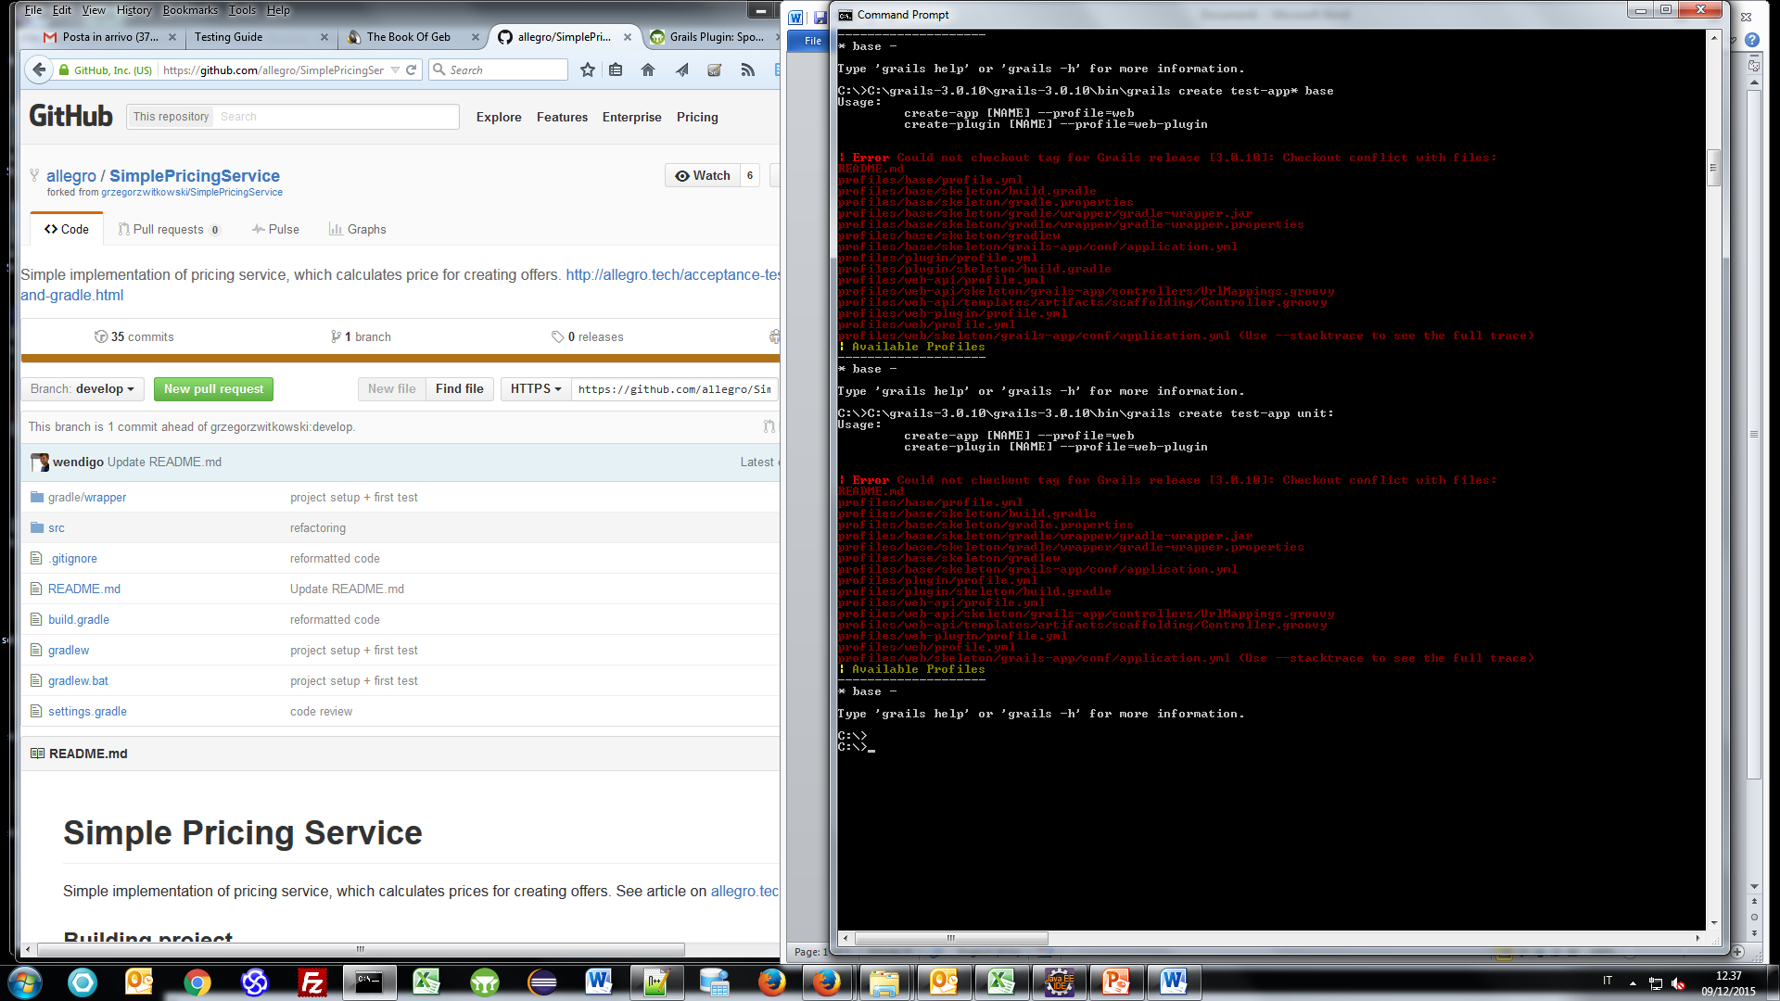
Spock Groovy – Spring Grails

Slide 30
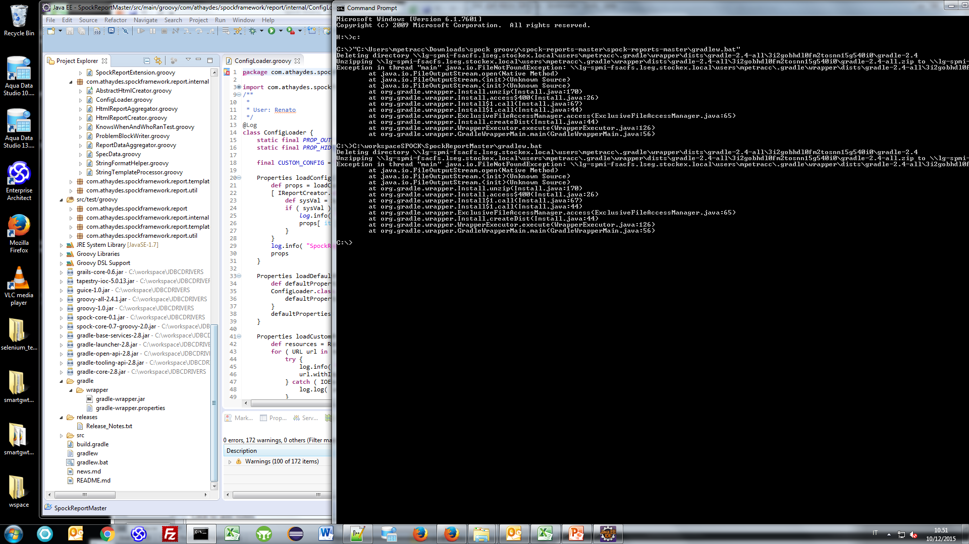
Spock Groovy – Spring Grails

Slide 31
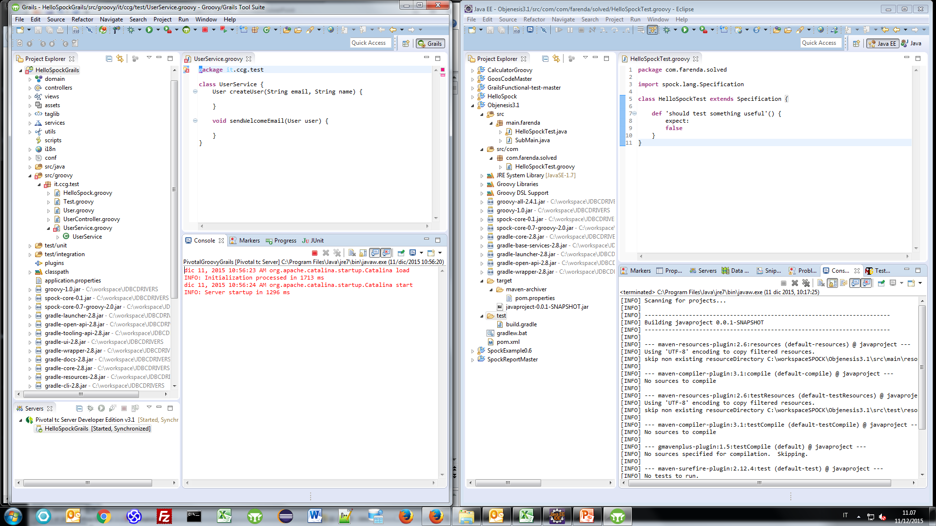
Spock Groovy – Spring Grails – TC Pivotal

